Slide 1
Cross Selling Credit Union
LISUM12: Data Glacier Project EDA Presentation

Slide 2
Team Details
Group Name: Team Coltenback
Name: Richard Coltenback
Email: rdcoltenback@gmail.com
Country: United States of America
College: Drew University
Specialization: Data Analyst
GitHub Repository Link: https://github.com/RColtenback/Cross-Selling-Data-Analysis.git

Slide 3
Problem Description
XYZ credit union in Latin America is performing very well in selling the banking products (e.g.: credit card, deposit account, retirement account, safe deposit box etc.). However, their existing customers are not buying more than one product which means bank is not performing well in cross-selling (Bank is not able to sell their other offerings to existing customer). XYZ Credit Union decided to approach Team Coltenback to solve their problem.

Slide 4
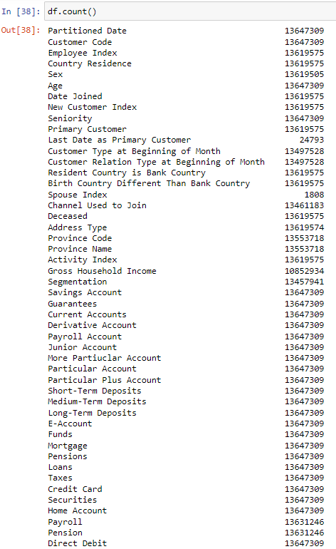
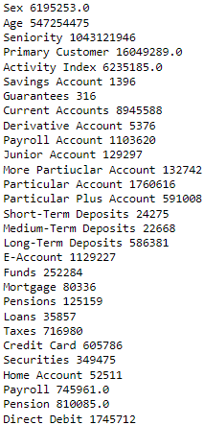
Exploratory Data Analysis
Count
Sum
I began the exploratory data analysis (EDA) by taking the little experience I gained from last week’s cleaning and transforming the data and applying it to this week’s assignment, but on a larger scale. I found all the count values of each variable and the sum of each variable to get a vague sense of how many accounts there were in all the options that the bank offered.

Slide 5
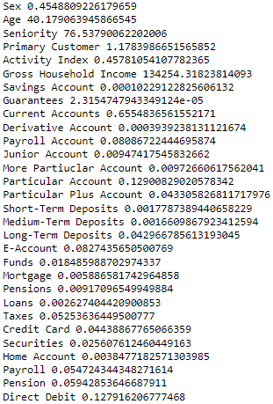
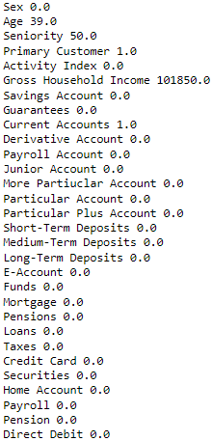
Exploratory Data Analysis
Means
Medians
I then found the means and medians of each variable to see which accounts of the bank were doing better than the others.

Slide 6
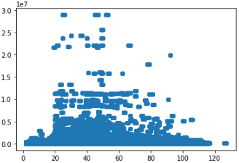
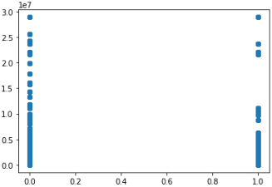
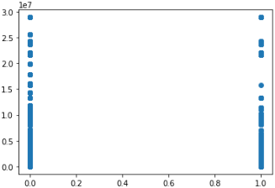
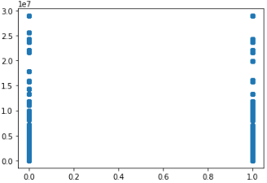
Exploratory Data Analysis
Gross Household Income by Age
Gross Household Income by E-Account
Then, I created some visualizations with the variables and compared them to Gross Household Income. I did this assuming the greater the wealth of a family, the greater the possible amount of money that could be trusted with the bank. Though the visualizations helped a little, they couldn’t paint a full picture.
Gross Household Income by Direct Debit
Gross Household Income by Activity Index

Slide 7
Exploratory Data Analysis
So, I decided to find the correlation (Pearson’s r) values between each of the variables, especially gross household income, and see if I could find any correlations between them. Although it wasn’t giving me all the information I wanted, specifically for the variables of Sex and Age, I changed a couple of the variables to make them able to be correlated.

Slide 8
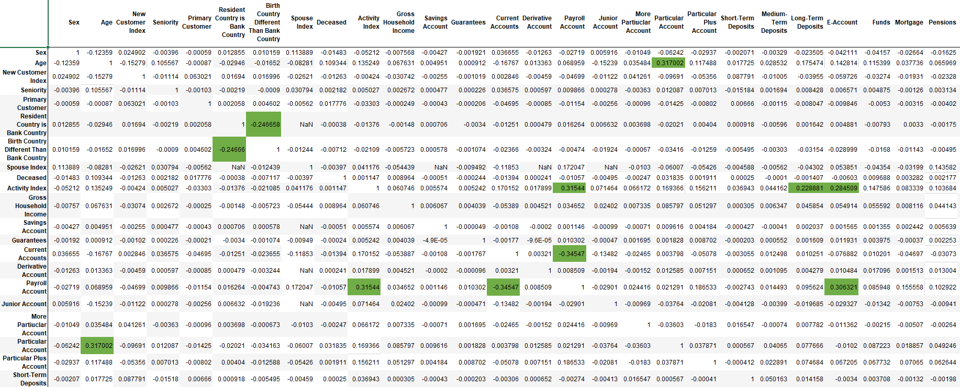
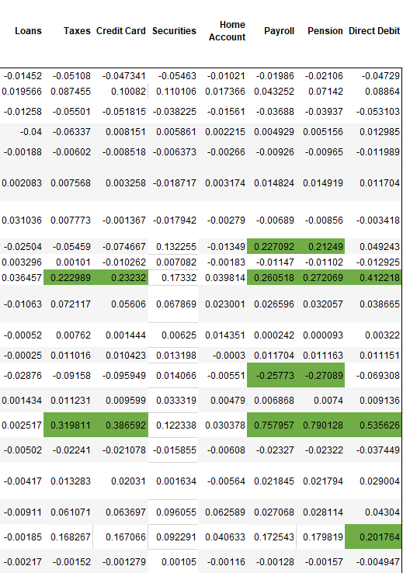
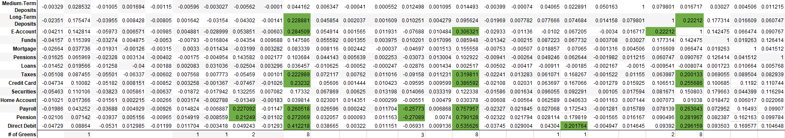
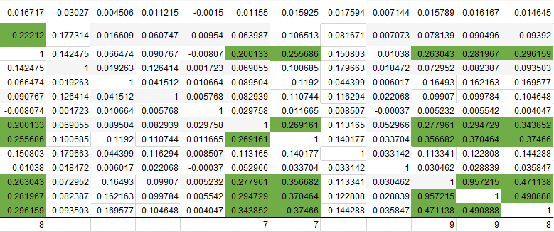
Full Correlation Table

Slide 9
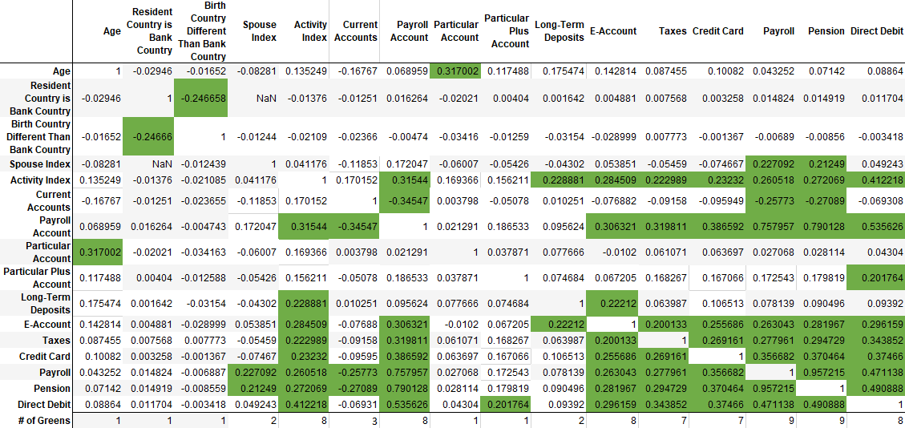
Statistically Significant Findings

Slide 10
Final Recommendation
I would like to begin this final recommendation with the saying that, “Correlation does not imply causation”. Although, trends say one thing, you are not guaranteed the outcome you seek. With that being said, my final recommendation is this. In the prompt, we are told the XYZ Credit Union is performing very well in the selling of their banking products. Although they aren’t where they’d like to be with cross selling to their existing customers, they are still doing well selling individual products. They might not be maximizing their revenue, but their business model is drawing in new customers and keeping them long term. Pushing new accounts on your existing customers could turn them away. I would say you could try cross selling to new customers that enter your credit union, but not the ones who have been loyal for many years. Despite this, there are ways of making more profit by cross selling certain accounts together. So, if you did want to try making more revenue through cross selling, this is how you could do it.

Slide 11
Final Recommendation
I’m going to begin by saying, from the correlation coefficient findings, gross household income is not a good variable to test bank success with. It wasn’t statistically significant with any other of the variables we used. The variables best correlated with other banking variables were activity index, payroll account, e-account, taxes, credit card, payroll, pensions, and direct debit. Looking deeper into a few of those variables, starting with activity index, we can see that it’s statistically significantly positively correlated with payroll accounts, long-term deposits, e-accounts, taxes, credit card, payroll, pensions, and direct debit. In short, this means that customers who are active with their account tend to also have multiple types of banking accounts, specifically the accounts listed above. This means that if you were trying to cross sell, do it with active customers and try getting them signed up for one of these account types, with a priority in direct debit, e-accounts, payroll accounts, pensions, payroll, taxes, and credit card, as these are the most used accounts out of all their customers. Moreover, these accounts are all statistically significantly positively correlated with each other.

Slide 12
Final Recommendation
If you have an older customer, the statistics show that they are more likely to open a particular account with the credit union. Also, particular accounts are one of the most popular accounts to have in this credit union. Thus, I would try pushing those types of accounts to older customers who don’t already have one.
Customers that already have an account at the credit union tend to not have a payroll account or pension. This probably means that they use other banking competitors to handle those accounts. Maybe with some more open minded customers, you could be able to convince them to switch over to your credit union. This would make those variables more highly correlated, especially if they are an active customer, and create more usage for your credit union.

Slide 13
Final Recommendation
Particular plus accounts have a statistically significantly positive relationship with direct debit. This makes sense as particular plus accounts deal with checking accounts and so do debit cards. Therefore, if someone is trying to sign up for a checking (particular plus) account, try offering direct debit, as it would line up with the wants of the customer.
To keep up with an increasing technologically driven world, the statistics and I highly recommend pushing e-accounts. It is positively correlated with many of the highest used banking accounts, and it provides simplicity and convenience for many, if not all, of your customers.

Slide 14
Final Recommendation
There are no statistically significant differences between gender and banking. Although 55% of the customers are male, there is no difference in the amount of accounts that both males and females use. Thus, you shouldn’t treat them differently, and you shouldn’t offer different accounts based on sex.
Finally, using the means of each of the different banking account types, I have found that the top five most used accounts are: particular account, direct debit, e-account, payroll account, and pension; and the five least used accounts are: guarantees, savings account, derivative account, medium-term deposits, and short-term deposits. With this information, you can continue to promote what is working best for the XYZ Credit Union, or try promoting the lesser used accounts in hopes of attracting different types of customers. However, I wouldn’t try and deviate too far from what is already being done, since the XYZ Credit Union is doing well already.

Slide 15
Modeling Technique
The best models for this problem/dataset should be predictive models. Specifically, models that use linear and multiple regression. Using the statistically significant values from the correlation coefficient table, along with means, medians, counts, sums, and regression equations, we can attempt to predict the best combination of cross selling techniques for the XYZ Credit Union.

Slide 16
Thank you!

